Slide 1
Chapter 1
Professional Nursing
Notes:
This chapter presents an overview of professional nursing practice, discussing the wide variety of roles and responsibilities that nurses fulfill to meet society’s health care needs.

Slide 2
Professional Nursing Practice
(1 of 3)
Domains of nursing practice
Definitions of nursing
Notes:
As a nurse, you are at the forefront of patient care (Fig. 1.1).
As a nurse, you: (1) offer skilled care, (2) advocate for patients’ rights, (3) teach patients to manage their health, (4) support patients and their caregivers, and (5) help them navigate the complex health care system. You can practice in virtually all health care settings and communities.
Nurses work in acute care facilities, long-term care, home care, community health, public health centers, schools, ambulatory clinics, or outpatient clinics.
Recipients of care include individuals, groups, families, and communities.
Definitions: Basic themes of caring, health, and illness
Florence Nightingale
Henderson
The American Nursing Association (ANA)).
Shown is Fig. 1-1, Nurses are frontline professionals of health care, from the textbook.

Slide 3
Professional Nursing Practice
(2 of 3)
Nursing’s view of humanity
  Physiologic
  Psychologic
  Spiritual
  Intellectual
  Career
  Environmental
Notes:
View of Humanity:
7 dimensions of wellness
These dimensions are interrelated and not separate entities.
A person is in constant interaction with a changing environment.

Slide 4
Professional Nursing Practice
(3 of 3)
Scope of nursing practice
  Entry level
  Certification
  Advanced practice
    Master’s degree
    Doctorate
Notes:
Scope of practice depends on their educational preparation, experience, and state law.
Entry-level nurses, associate or baccalaureate degrees, function as generalists.
Certification is a formal way to obtain professional recognition for expertise in a specialty area.
Advanced practice registered nurse (APRN) is educated at the master's or doctoral level.
They have advanced education in pathophysiology, pharmacology, and health assessment and expertise in a specialized area of practice.
Include clinical nurse specialists, nurse practitioners, nurse midwives, and nurse anesthetists.
The doctor of nursing practice (DNP) degree is a practice-focused terminal nursing degree.
Research-focused doctorate (PhD) typically as nurse faculty, clinical experts, researchers, and health care system executives.

Slide 5
Standards of Professional Nursing Practice
Standards of Practice
Standards of Professional Performance
Notes:
ANA definitions:
The Standards of Practice describe a competent level of nursing care, based on the nursing process.
The Standards of Professional Performance describe behavioral competencies expected of a nurse.
Ethical practice
Effective communication
Collaboration with team, patients, caregivers

Slide 6
Influences on Professional Nursing Practice (1 of 5)
Complex health care environments
  Expanding knowledge and technology
  Diverse populations
  Consumerism
Notes:
Expanding knowledge and technology:
The increased treatment, diagnostic, and care options available are changing care delivery and extending patients’ lives.
Discoveries in genetics are changing the way we think about diseases.
Ethical dilemmas arise about the use of new scientific knowledge and the disparities that exist in patients’ access to advanced health care.
Diverse populations:
People are living longer, with the number of people with chronic illnesses and multiple co-morbidities increasing. They see different health care providers and often move among health care settings.
Nurses are caring for a more culturally and ethnically diverse population and must consider the patient’s and caregiver’s cultural beliefs and values.
Consumerism:
Many patients today want to be more engaged in their health care.
Nurses help patients access, interpret, and use safe health care information.
Review Fig. 1-2, The patient, family, and nurse collaborate as part of coordinating high-quality care, in the textbook.

Slide 7
Influences on Professional Nursing Practice (2 of 5)
Influences on health care systems
  Health care financing
    Medicare prospective payment system (PPS)
    Health maintenance organizations (HMOs)
    Preferred provider organizations (PPOs)
    Value-based purchasing
Notes:
Changes in health care systems that influence nursing care delivery are usually in an effort to contain spending and provide more cost-effective health care delivery.
The U.S. health system is a mix of public and private, for-profit and nonprofit insurers and health care providers.
Medicare program
Other managed care systems
PPS payment for Medicare patients is based on a flat fee by disease or problem.
Quality measures also determine payment based on providers’ performance.

Slide 8
Influences on Professional Nursing Practice (3 of 5)
  Healthy Policy
    Affordable Care Act (ACA)
    Accountable Care Organizations (ACO)
Notes:
ACA’s main goal was to increase access to health care.
Emphasized teamwork, care coordination, and quality care.
Encourages the creation of accountable care organizations (ACOs) to coordinate care for Medicare patients.

Slide 9
Influences on Professional Nursing Practice (4 of 5)
Supporting professional practice
  Professional nursing organizations
    American Nurses Association (ANA)
    Professional specialty organizations
  American Nurse’s Credentialing Center’s Magnet Recognition Program
Notes:
The primary professional nursing organization is the American Nurses Association.
Many professional specialty organizations include the American Association of Critical-Care Nurses (AACN), National Association of Orthopedic Nurses (NAON), and Oncology Nurses Society (ONS).
Professional organizations promote quality patient care and professional nursing practice.
Develop standards of practice and codes of ethics
support research
Lobby for legislation and regulations
Research the causes of errors.
Develop strategies to prevent future errors.
The American Nurses Credentialing Center's Magnet Recognition Program® “recognizes health care organizations that create environments in which high-quality nursing care is provided.

Slide 10
Influences on Professional Nursing Practice (5 of 5)
Nursing competencies:
  Patient-Centered Care
  Interprofessional Partnerships
  Safety
  Quality Improvement
  Informatics and Health Care Technology
  Evidence-Based Practice
Notes:
The Future of Nursing: Leading Change, Advancing Health, acknowledged the link between professional nursing practice and health care delivery.
Report discussed how health care providers, including nurses, were not being adequately prepared to provide the highest quality care possible.
The Robert Wood Johnson Foundation funded the Quality and Safety Education for Nurses Institute (QSEN).
QSEN defined specific competencies that nurses need to have to practice safely and effectively in today’s complex health care system.
Review Table 1-1, Nursing Competencies, in the textbook.

Slide 11
Patient-Centered Care
Patient-centered care
  Quality
  Safety
Caregivers involved in decisions
Notes:
With patient-centered care, patients and caregivers seek and receive care from competent and knowledgeable health care professionals.

Slide 12
Clinical Judgement
Nursing knowledge to assess situation
  Make decisions
  Solve problems
  Skills developed through experience
Notes:
Nurses identify priority problems and generate best possible solutions for safe patient care.
Case studies and review questions throughout the book promote use of clinical judgement.

Slide 13
The Nursing Process in Nursing Practice (1 of 2)
Phases of nursing process
  Assessment
  Diagnosis
  Planning
  Implementation
  Evaluation
Revision of the plan
Notes:
Assessment—collection of subjective and objective data on which to base of the plan of care.
Diagnosis—the act of analyzing the assessment data and making conclusions.
Planning—patient outcomes or goals are developed, and nursing interventions are identified to accomplish the outcomes.
Implementation—action phase with the use of nursing interventions.
Evaluation—continual activity; it is determined whether the patient outcomes were met.
May need to obtain more assessment and revise diagnoses, outcomes, and interventions.

Slide 14
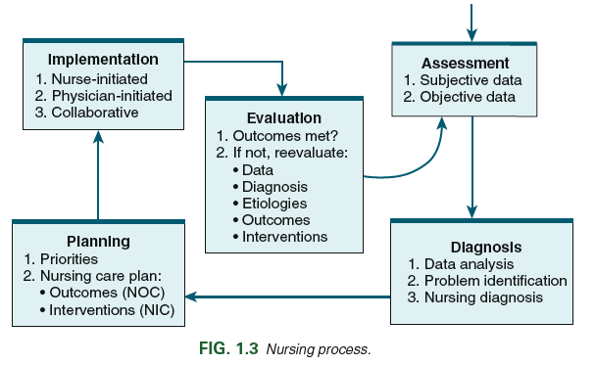
Nursing Process in Nursing Practice (2 of 2)
Notes:
The nursing process is a problem-solving approach. Once started, it is a continuous and cyclic.
Shown is Fig. 1-3, Nursing process, from the textbook.

Slide 15
Nursing Practice Frameworks
ADPIE
Tanner’s Model of Clinical Judgment Model
National Council of State Boards of Nursing’s Clinical Judgment Model (CJM)
Notes:
Nursing Process (ADPIE)
Tanner’s Model includes phases of Noticing, Interpreting, Responding, and Reflecting
CJM was designed to test clinical judgement on NCLEX-RN.
All 3 models emphasize assessment, making decisions, taking action, and evaluating outcomes.
Assess, Act, Reassess is a “shortened version”.
See Fig. 1-4 in the textbook.

Slide 16
Concept Map
Visual diagram of the nursing process
  Patient problems and interventions
  Relationship to clinical data
Notes:
Concept mapping is used to teach the nursing process and care planning
Various formats for concept maps

Slide 17
Conceptual Care Map
Notes:
Conceptual care maps blend a concept map and a nursing care plan.
Assessment data used to identify the patient’s primary health concern is in the center.
Diagnostic testing data, treatments, and medications surround the assessment data.
Positioned below are clinical problems or nursing diagnoses that represent the patient’s responses to the health state.
Listed with those are the supporting assessment data, outcomes, nursing interventions with rationales, and evaluation.
After completing the map, you draw connections between identified relationships and concepts.
Shown is an example of a conceptual care map, from the student Evolve site.
http://evolve.elsevier.com/Lewis/medsurg

Slide 18
Continuum of Patient Care
Health care settings
Transitions of care
  Patient movement between practitioners, settings, and home
  Nurses play critical role in care coordination that meets patient ‘s needs and facilitates safe, quality care
Notes:
Depending on their health status, patients often move among a multitude of different health care settings.
Decisions about the best setting for obtaining health care often depend on the cost of care and the patient’s health care insurance plan and personal finances.
Community-based health care settings include ambulatory care, transitional care, and long-term care.
Transitional care settings provide care in between the acute care and home or long-term care setting.
Long-term care refers to the care of patients for a period greater than 30 days. Long-term care facilities include skilled nursing facilities, assisted living facilities, and residential care facilities.
Transitions of care refer to patients moving between health care practitioners, settings, and home as their condition and care needs change. As a nurse, collaborating with other members of the health care team is critical.

Slide 19
Delivery of Nursing Care
Care delivery models
  Team care
  Total patient care
  Case management
  Telehealth
Notes:
Nurses deliver patient-centered care in collaboration with the health care team and within the framework of a care delivery model.
Team care models involve a group of providers who work together to deliver care. A professional nurse is usually the team leader, managing and coordinating care with others
Licensed practical/vocational nurses (LPN/VNs)
Unlicensed assistive personnel (UAP).
In total patient care models, you are responsible for planning and providing all care.
Case management involves managing the patient’s care with other health care team members. A registered nurse assumes the role of case manager.
Telehealth nursing provides health care and information using telehealth technologies. Telehealth can increase access to care.
See Fig. 1.45 in the textbook.

Slide 20
Supporting Caregivers
Caregivers
  Valuable members of the health care team
  Need guidance and support
  Major needs
    Information
    Communication
    Access
Notes:
Caregivers need information about the patient’s status, treatment plan, and prognosis.
Communicate with caregivers in rounds and patient care conferences.
Caregivers need access to the patient and the option to be present for invasive procedures.

Slide 21
Interprofessional Partnerships
Interprofessional team
Coordinating care
  Communication
  Clinical pathways
Notes:
The interprofessional team is composed of providers from various disciplines, working together and sharing their expertise to provide customized care. ( See Table 1.2)
Effective communication is key to fostering teamwork and coordinating care.
Clinical pathways are interprofessional care plans that outline the care and desired outcomes a specific time period for patients with a specific diagnosis (Fig. 1.6)

Slide 22
Communication
  SBAR
    Situation
    Background
    Assessment
    Recommendation
  CUS
    Concerned
    Uncomfortable
    Safety
Notes:
The SBAR model offers a structured way to discuss a patient’s condition between team members.
Review Table 1.4, Guidelines for Communicating Using SBAR, in the textbook.
The model, Concerned, Uncomfortable, Safety (CUS) provides another organized way to alert team members of a patient situation.

Slide 23
Delegation and Assignment
Licensed practical/vocational nurses (LPN/VN)
Unlicensed assistive personnel (UAP)
RN to RN
Assignment within scope of practice
Notes:
Delegation allows a care provider to perform a specific nursing activity, skill, or procedure that is beyond their usual role. When used appropriately, delegation and assigning results in safe, effective, and efficient patient care.
Delegation usually involves tasks and procedures that licensed practical/vocational nurses (LPNs/VNs) and assistive personnel (AP) perform.
Delegation can occur among professional nurses. For example, if one RN has accountability for an outcome and asks another RN to perform a specific intervention related to that outcome, that is delegation.
Assignment is used when you direct a LPN/VN or UAP to do an activity or procedure that is part of their everyday job.
See Table 1.5 for the 5 Rights of Delegation.

Slide 24
Delegation in Nursing Practice
See Table 1-5 Five Rights of Delegating
Notes:
Delegation is a skill that is learned and you must practice to be proficient in managing patient care.
Review Table 1-5, Five Rights of Delegation, in the textbook.

Slide 25
Safety
National Quality Forum
  Serious reportable event (SRE)
  “Never Event”
  Safe practices
National Patient Safety Goals
  Sentinel event
Failure to rescue (FTR)
Notes:
The National Quality Forum (NQF) uses the term serious reportable event (SRE), also called a never event, to describe serious, largely preventable, and harmful clinical events.
To reduce the occurrence of SREs, the NQF has a list of effective Safe Practices that health care settings should use to improve safe patient care (www.qualityforum.org).
The Joint Commission (TJC), an accrediting agency for health care organizations, gathers and reports data on serious errors they call sentinel events—a patient safety event not related to the patient’s illness or underlying condition that results in death, permanent harm, or severe temporary harm.
To address specific patient safety concerns, TJC issues National Patient Safety Goals (NPSGs). NPSGs promote patient safety by giving evidence-based solutions to common safety problems.
Failure to rescue (FTR) occurs when there is failure or delay in recognizing a patient has developed complications.
Table 1.6 lists current NPSGs.

Slide 26
Safety and Quality Improvement
National Patient Safety Goals
See Table 1-6 National Patient Safety Goals
Notes:
The Joint Commission (TJC) issues the National Patient Safety Goals (NPSGs).
NPSGs promote patient safety by offering evidence-based solutions to common safety problems.
Review Table 1-6, National Patient Safety Goals, in the textbook.

Slide 27
Quality Improvement
QI programs
Interprofessional team efforts
National Database of Nursing Quality Indicators
Notes:
Quality improvement (QI) programs involve systematic actions that monitor, assess, and improve health care quality.
QI is an interprofessional team effort that is required by accrediting agencies. As part of your nursing practice, you will collect data using QI tools, implement interventions to improve quality of care, and monitor patient outcomes.
Fig. 1.5 shows an example of a QI system.
The National Database of Nursing Quality Indicators (NDNQI) provides data on nursing-sensitive measures to evaluate the impact of nursing care on patient outcomes. Patient outcomes are nursing sensitive if they improve with a greater quantity or quality of nursing care.

Slide 28
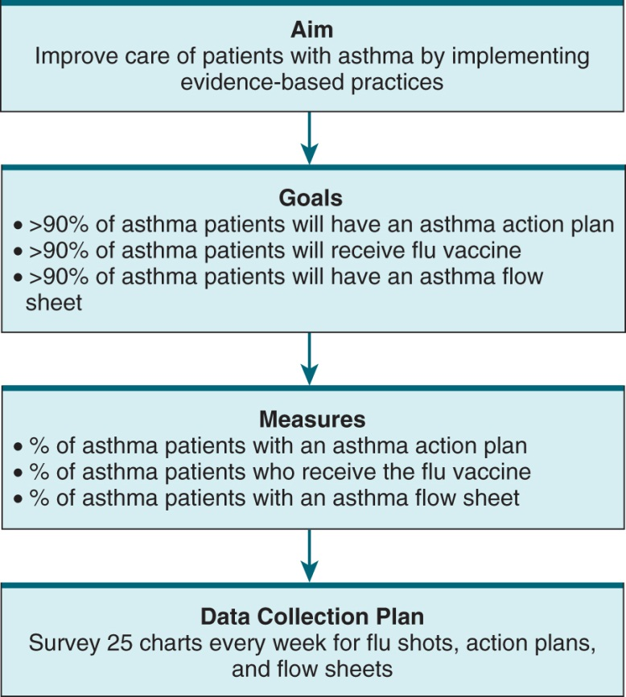
Quality Improvement System
Quality improvement system. (Adapted from Courtlandt CD, Noonan L, Leonard GF: Model for improvement—part 1: A framework for health care quality, Ped Clin North Am 56:757, 2009)
Notes:
Table 1-7 lists the current NDNQI.
Review Table 1-7, National Database of Nursing Quality Indicators, in the textbook.
Shown is Fig. 1-6, Quality Improvement System, from the textbook.

Slide 29
Informatics and Healthcare Technology
Computers and mobile devices
Medication administration applications
Computerized provider order entry
Protected health Information (PHI)
Electronic health record (EHR)
Notes:
Technology advances have increased the efficiency of nursing care, improving the work environment and the care nurses provide.
Computers and mobile devices allow you to document at the time you deliver care and give you quick and easy access to information, such as clinical decision-making tools, patient education materials, and references.
Medication administration applications improve patient safety by flagging potential errors, such as look-alike and sound-alike medications and adverse drug interactions, before they can occur.
Computerized provider order entry (CPOE) systems can reduce errors caused by misreading or misinterpreting handwritten orders.
Protected health information (PHI) is highly sensitive. The Health Insurance Portability and Accountability Act (HIPAA) is part of federal legislation that addresses the use and disclosure of PHI in order to protect such information.
An electronic health records (EHRs), also called electronic medical records, is a computerized record of patient information. It is shared among all health care team members involved in a patient’s care and moves with the patient—to other providers and across care settings.
See Fig. 1.8 for EHD.

Slide 30
Evidence-Based Practice (1 of 2)
Problem-solving approach to clinical decision making
Using the best available evidence, with your expertise and patient’s preferences, to make decisions and improve patient outcomes
Notes:
Evidence-based practice (EBP) uses the best available evidence (i.e., research findings, QI data), combined with clinician expertise and the patient’s unique circumstances and preferences, leading to better clinical decisions and improved patient outcomes.

Slide 31
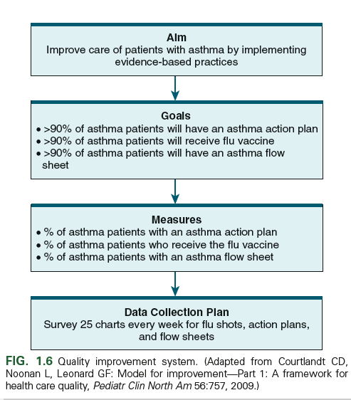
Evidence-Based Practice (2 of 2)
See Table 1-8 Steps of Evidence-Based Practice (EBP) Process
Notes:
Evidence-based practice (EBP) process has 6 steps.
Step 1 of the EBP process is asking a clinical question in the PICOT format:
P = patients/populations
I = intervention
C = comparison
O = outcome
T = time period
Step 2 of the EBP process is searching for and collection of evidence based on the clinical question.
Step 3 of the EBP process is critically appraising and synthesizing evidence found in the search. A successful critical appraisal process focuses on three essential questions: (1) What are the results? (2) Are the results reliable and valid? and (3) Will the results help me in caring for my patients?
Step 4 involves implementing the evidence in practice. The decision to implement change is made by combining the evidence, clinical judgment, and the preferences and values of patients and caregivers.
Step 5 of the EBP process is evaluating the outcome in the clinical setting. After implementing the practice change for a specific period, you should monitor outcomes to determine whether the change has improved patient outcomes.
The last step in EBP, #6, is to share the outcomes of the EBP change so that other health care providers and patients benefit from what you learned from your experience.
Review Table 1-8, Steps of Evidence-Based Practice (EBP) Process, in the textbook.

Slide 32
Audience Response Question (1 of 2)
A nurse teaches a student nurse about evidence-based nursing practice guidelines. Which statement, if made by the student nurse, indicates understanding of the teaching?
“Patient care is based on research findings instead of the expertise of the nurse.”
“Patient preferences should not be considered if guidelines are supported by evidence.”
“Nursing care provided is based on the best evidence for quality care and desired outcomes.”
“Practice guidelines are used so that professional decisions about patient care are unnecessary.”
Notes:
No input is needed to proceed.

Slide 33
Audience Response Question (2 of 2)
Answer: C
“Nursing care provided is based on the best evidence for quality care and desired outcomes.”
Notes:
Evidence-based practice is the use of best evidence (from research findings, quality improvement, and professional standards), clinician expertise, and patient preferences and values to support clinical decision making.

